Slide 1
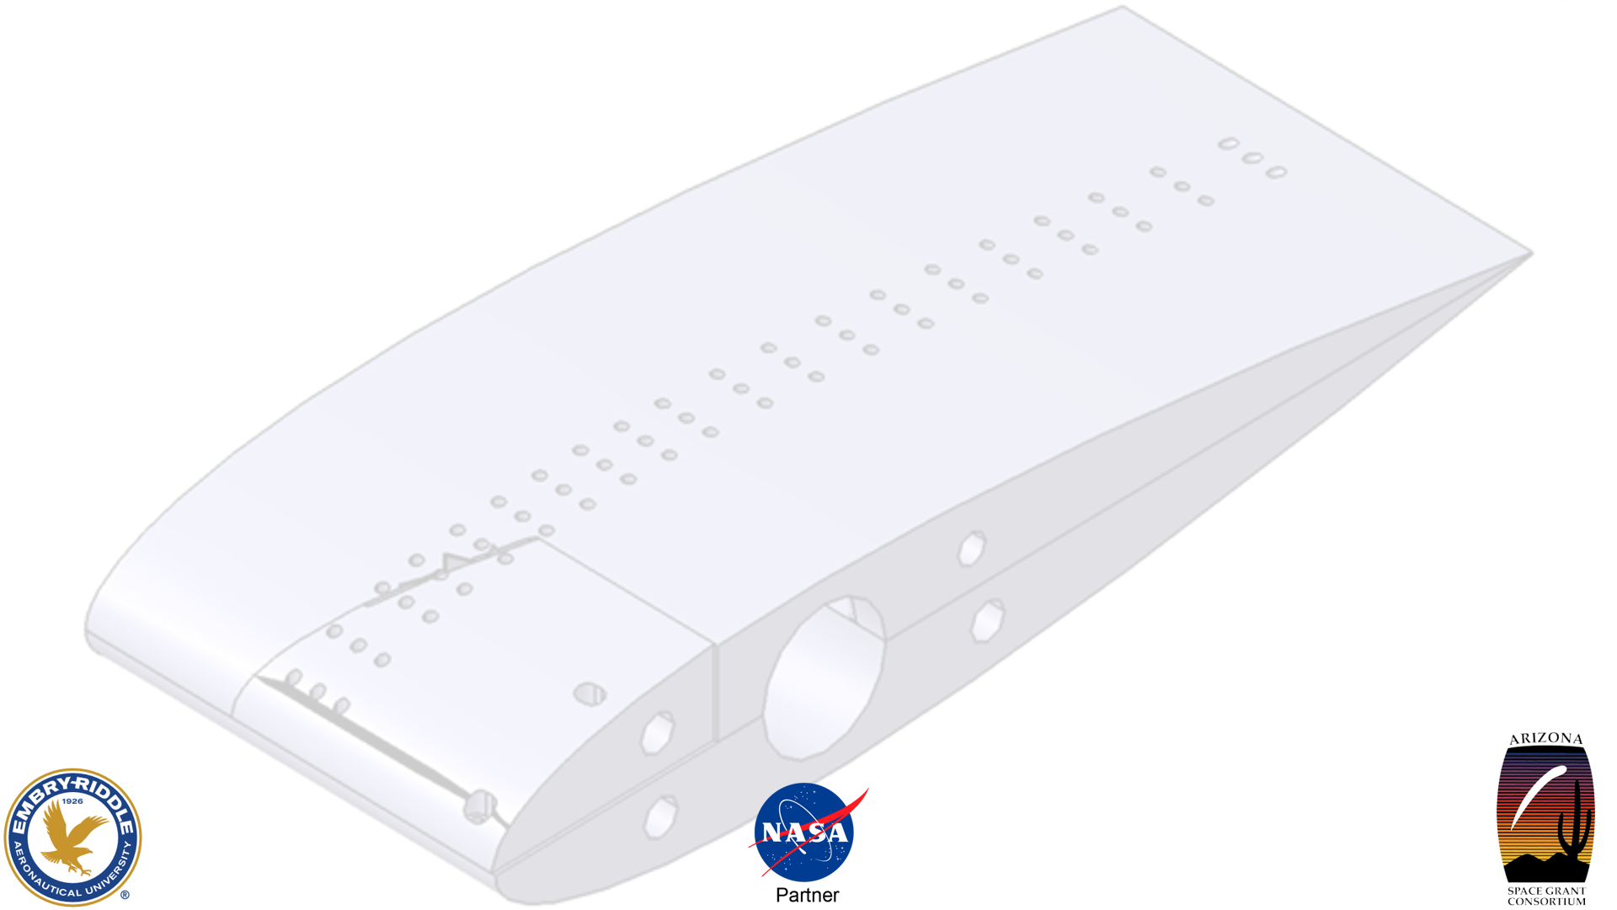
Experimental Investigation of Active Vortex Generators
David Aksenfeld, Robert Belz-Templeman
Dr. Lance Traub
Embry-Riddle Aeronautical University
Arizona Space Grant Symposium
4/17/2021
The material contained in this document is based upon work supported by a National Aeronautics and Space Administration (NASA) grant or cooperative agreement. Any opinions, findings, conclusions or recommendations expressed in this material are those of the author and do not necessarily reflect the views of NASA. This work was supported through a NASA grant awarded to the Arizona/NASA Space Grant Consortium.

Slide 2
Problem
Improving wing aerodynamics
Difficulties of integrating active flow control into actual aircraft

Slide 3
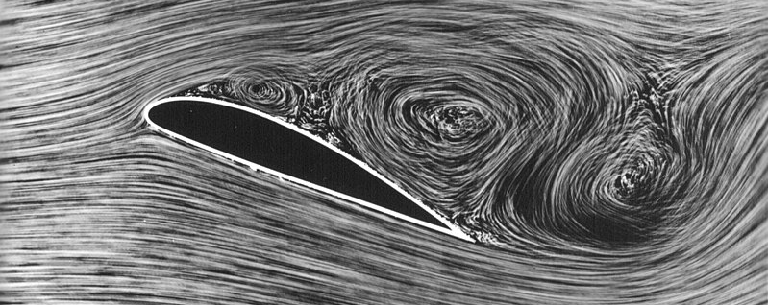
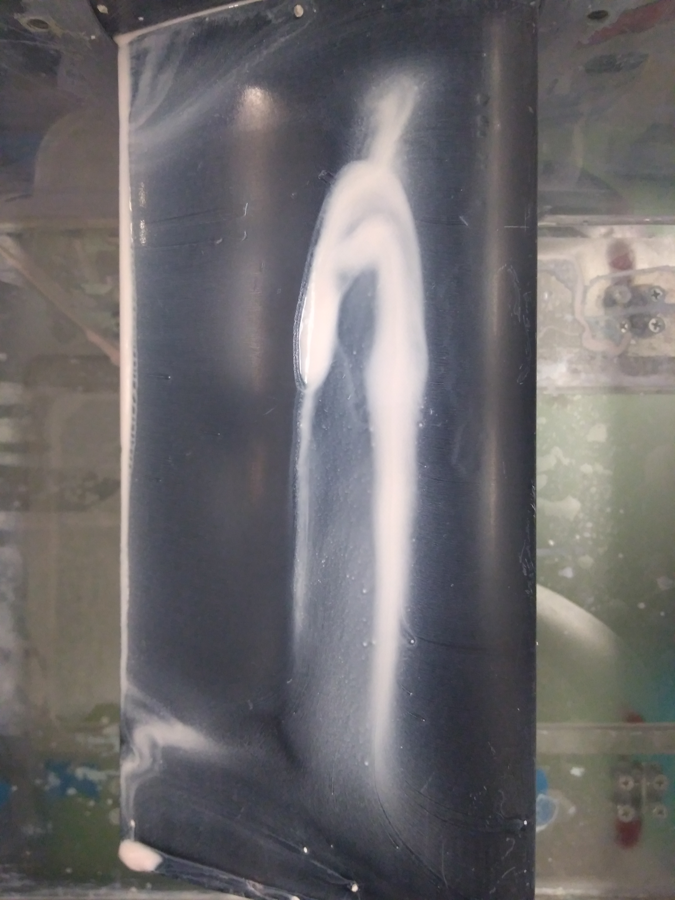
Flow Separation
High angle of attack
Laminar separation bubble
Licensed under Creative Commons Attribution 3.0
Author’s Photo

Slide 4
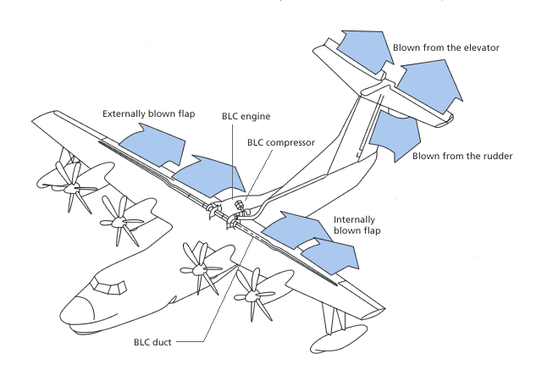
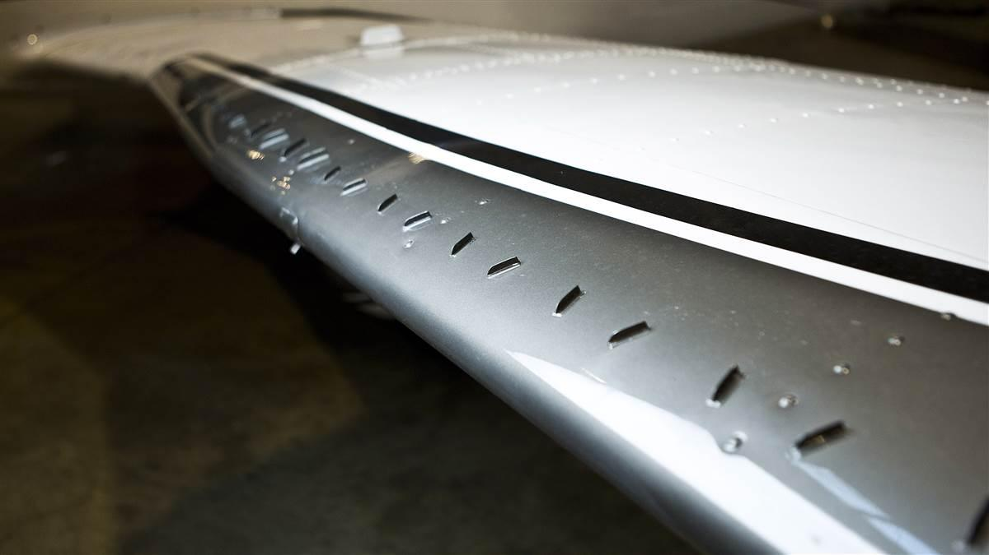
Flow Control
Passive
Active
“What Am I? Vortex Generators,” AOPA
"Performance of the State-of-the-Art US-2," ShinMaywa

Slide 5
Objectives
Combine the benefits of vortex generators and active flow control
Simple integration
  Feasible to implement on aircraft
Delay flow separation to higher angles of attack (AOA)
Eliminate or reduce laminar separation bubble

Slide 6
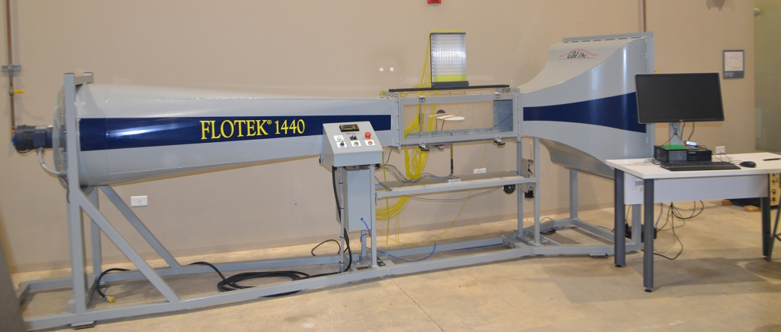
Testing Methods
Wind tunnel testing
  Force Balance
  Surface pressure measurements
  Surface flow visualization
"Flotek 1440," GDJ INC.

Slide 7
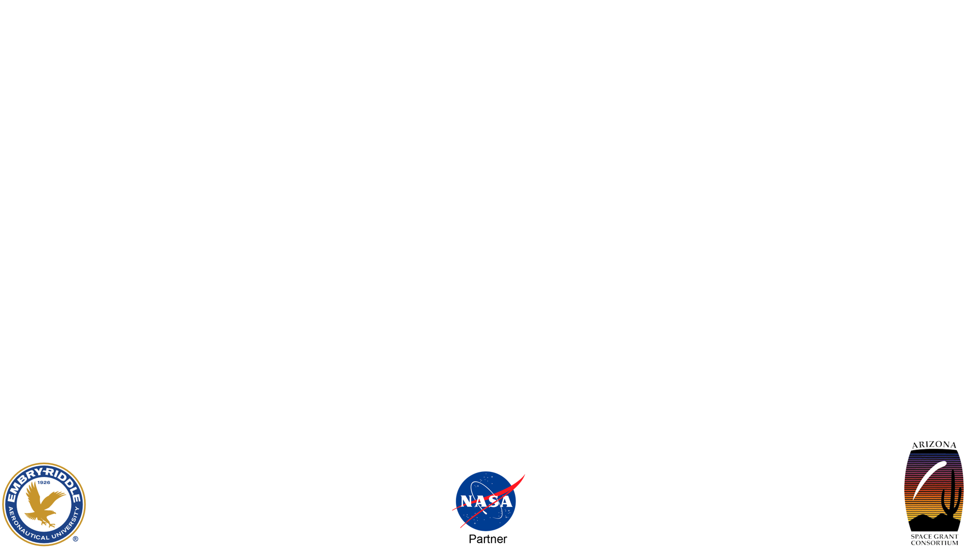
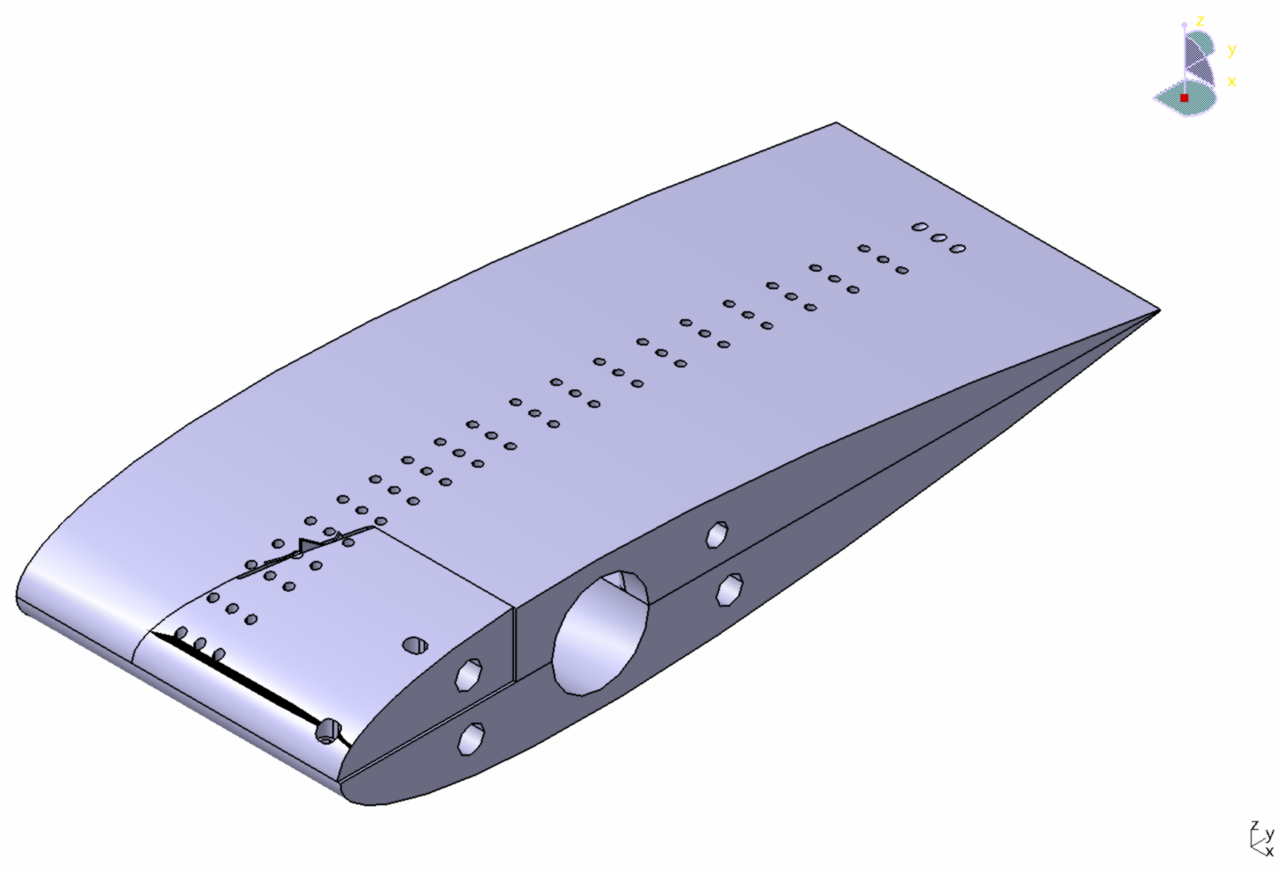
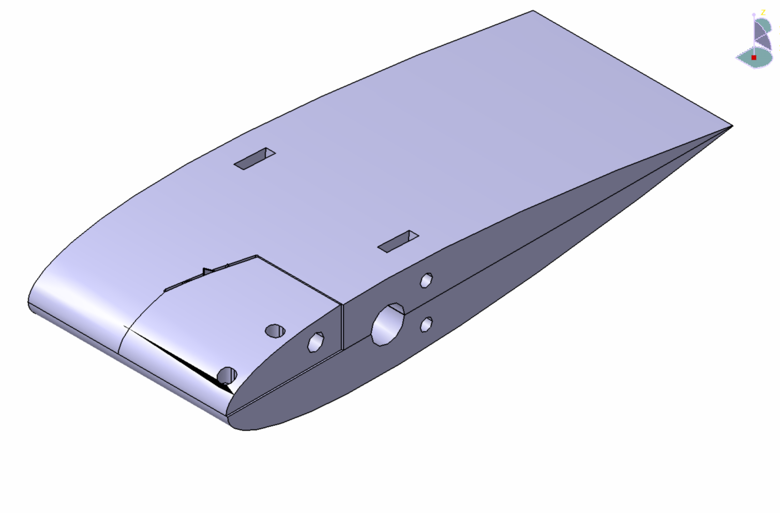
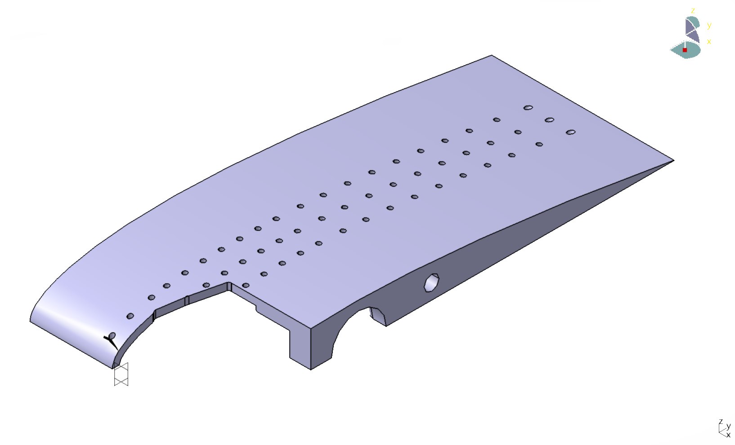

Test Models
[show CAD of each configuration]
Tolerance block

Slide 8
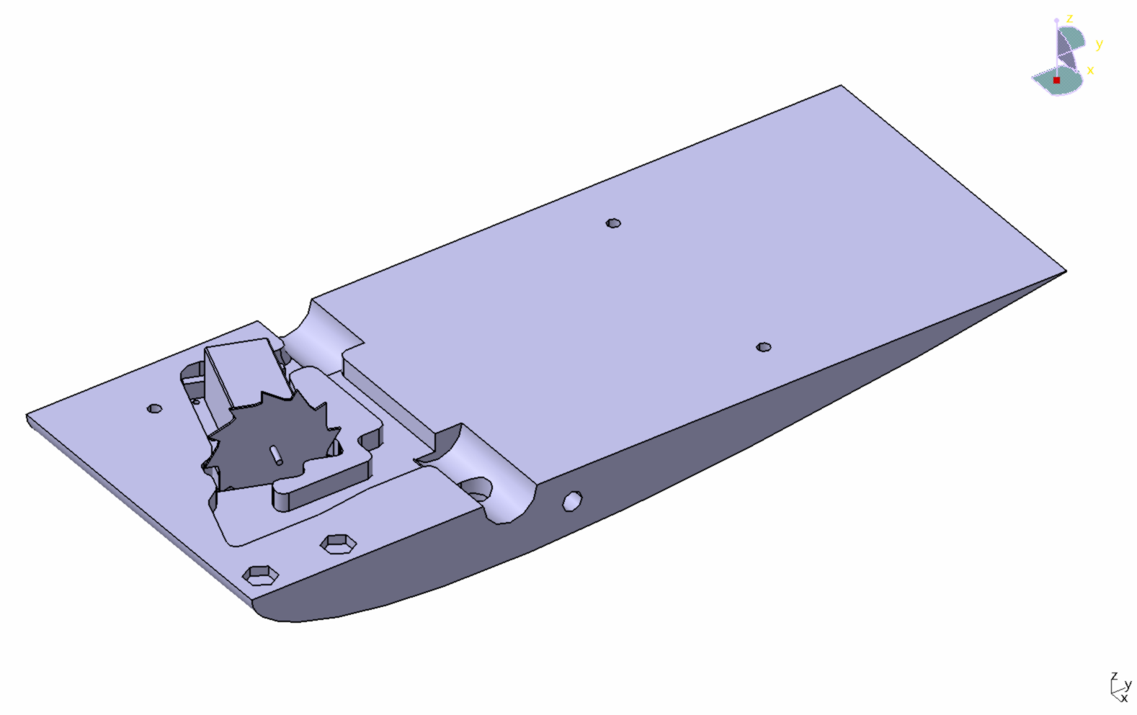
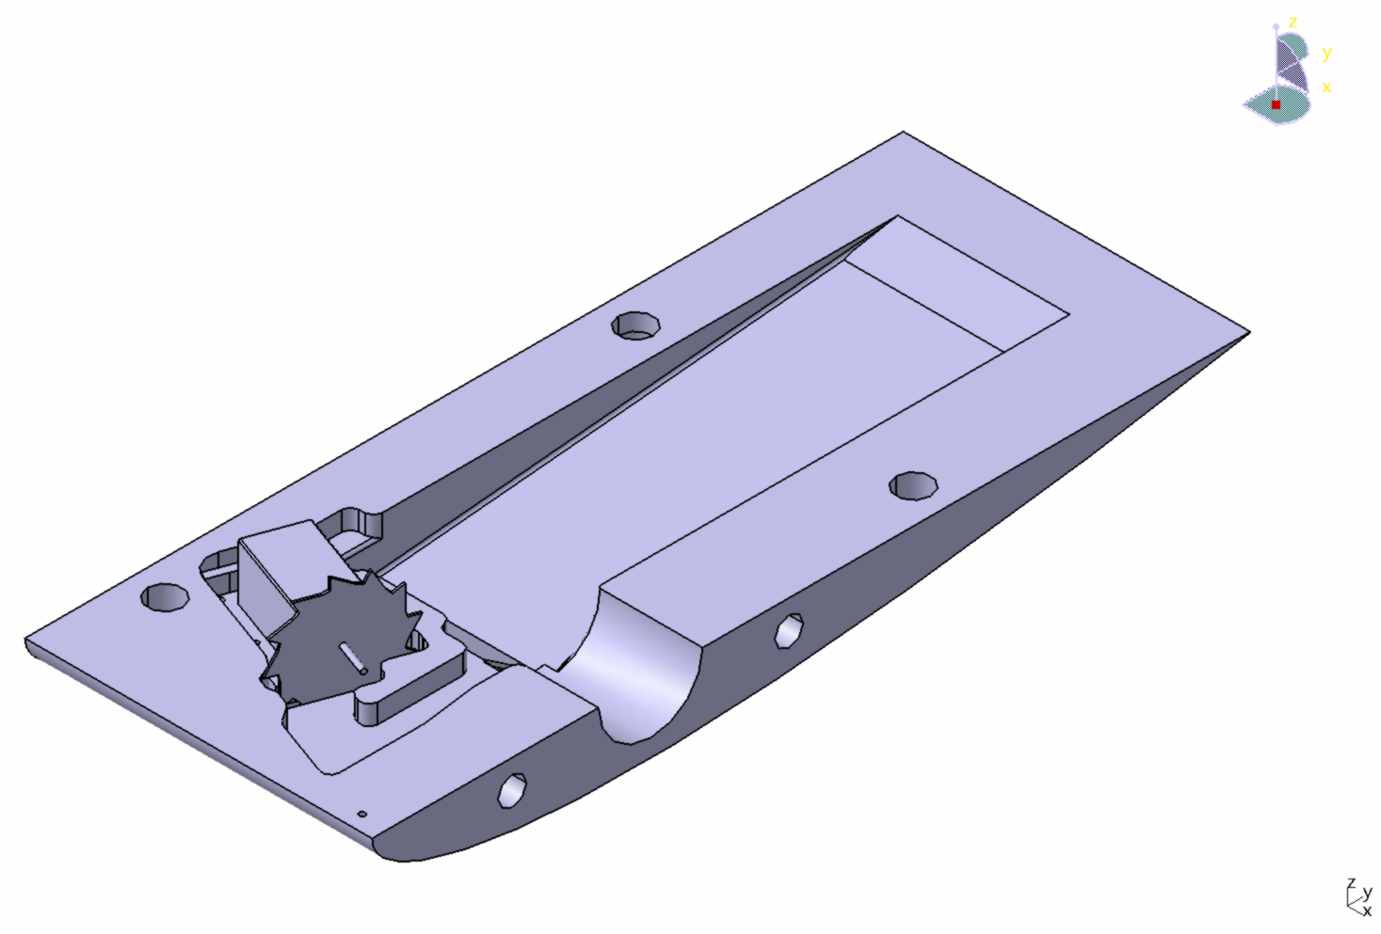
Test Models
Motor
Vortex Generator Disk
Photodiode/transistor location

Slide 9
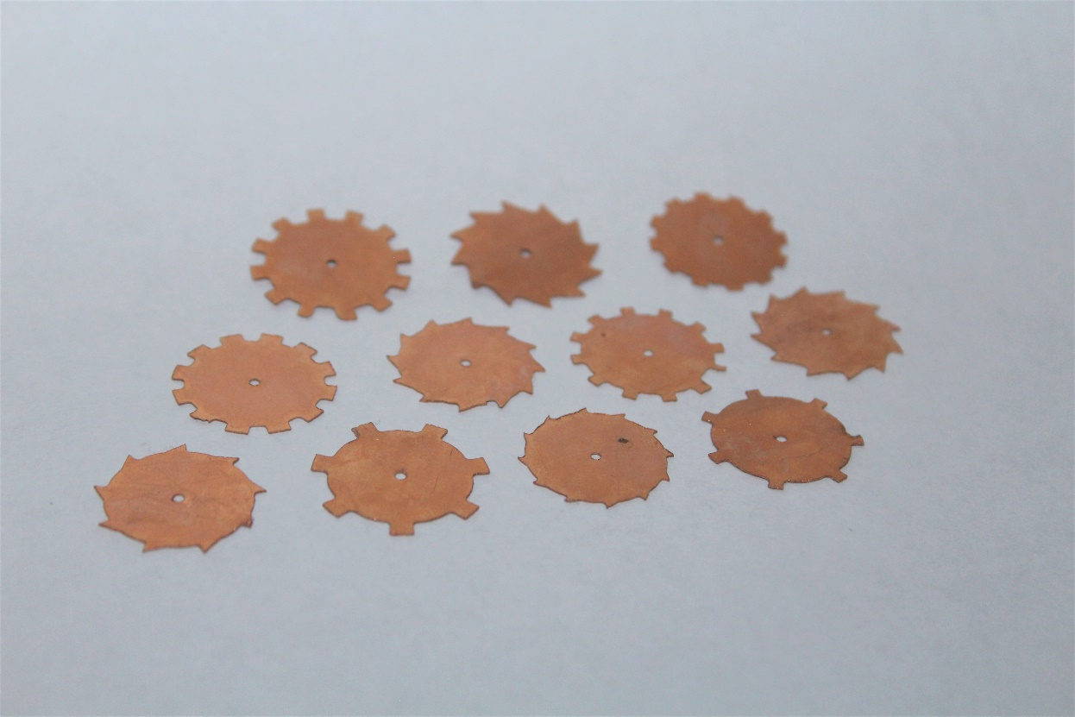
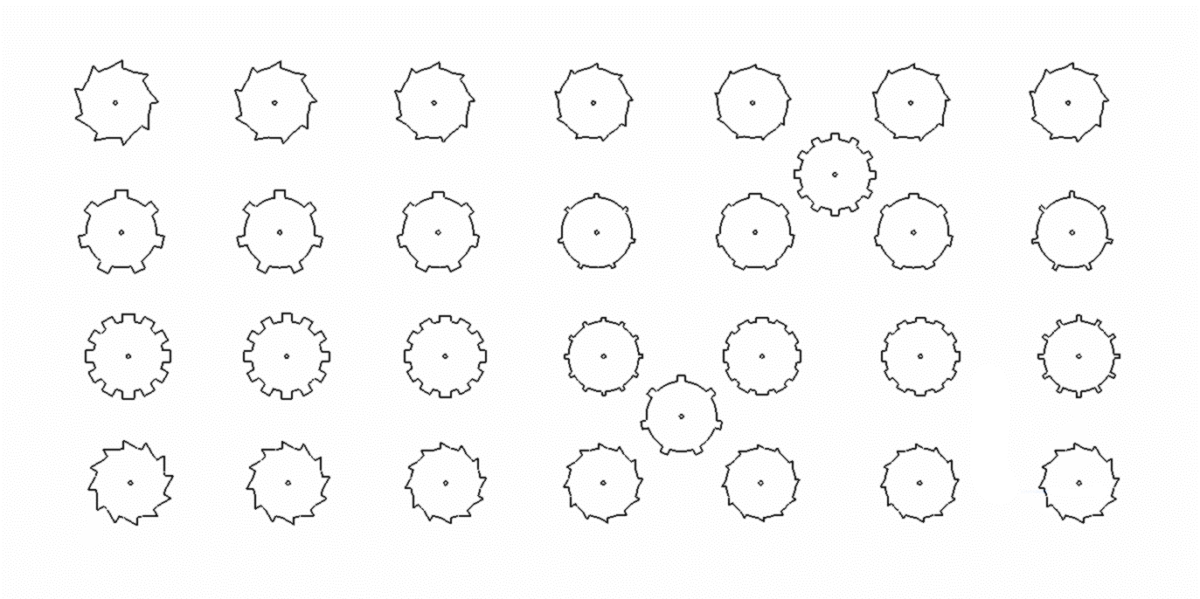
Test Models

Slide 10
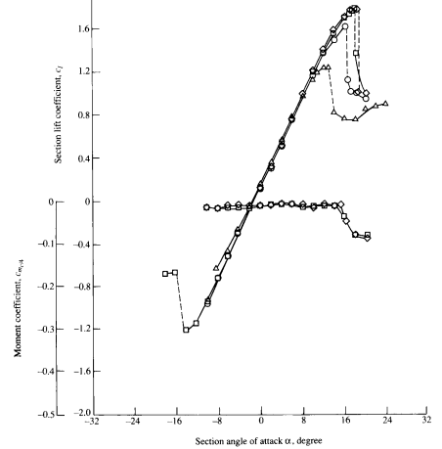
Analysis
Force balance data
  Lift, drag plots
Surface pressure measurements
  Pressure distribution plots
Surface flow visualization
Anderson, J.D Fundamentals of Aerodynamics

Slide 11
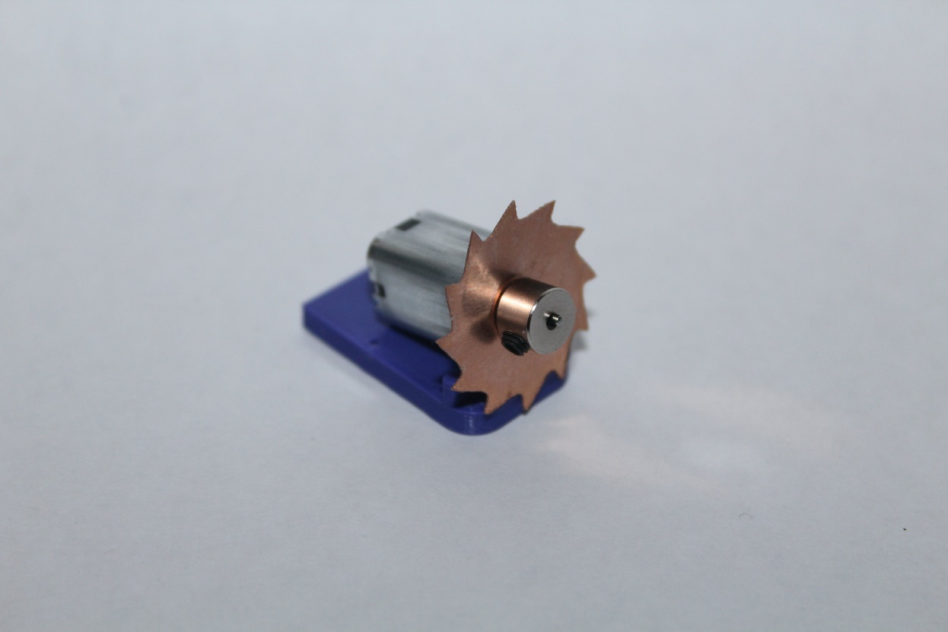
Progress
Design completed
Electronics tested
Manufacturing in progress

Slide 12
Future Steps
Complete testing
Analyze test data
  Determine best disk geometry and frequency
Share results
  Publish findings in a research journal

